Slide 1
Healthy Eating

Slide 2
MealMate: Food Optimization
Xueying(Alicia) Yang, Uma Aiyer, Alexander Hartman

Slide 3
Business Problem
Users do not experiment with new recipes
Lack of functionality to search through recipes
Not a personalized recommendation
Epicurious could provide users tailored recipes to:
Increase its user base
Build additional functionality into their webpage and apps

Slide 4
MealMate: A potential solution
We are looking to:
Optimize Protein per meal (target audience values this)
Recipes for Time constrained individuals
Key objectives:
Users can explore new recipes while eating healthy
Engagement with Epicurious platform can increase

Slide 5
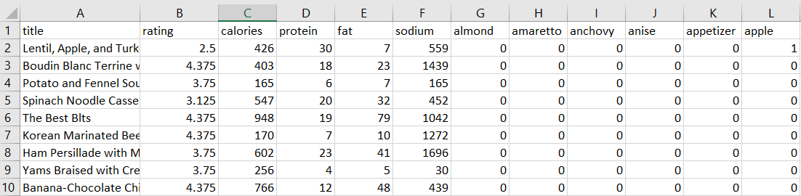
Data
Data Set: Epicurious Recipes
Title = Text
Rating, Calories, Proteins, Fat, Sodium= Numerical
Ingredients = Binary

Slide 6
Data Cont.
Data cleaning:
Empty data
Incoherent data (e.g. ratings = 0)
Unwanted columns (e.g. #CakeDay)
Calories, fat and sodium

Slide 7
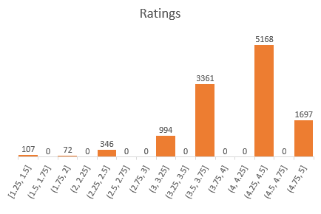
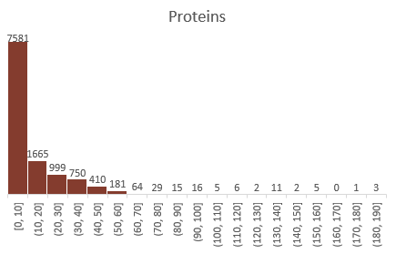
Data Cont.
Ratings are left skewed… while proteins are right skewed

Slide 8
Model Building
Meal optimization
Decision Variables:
Recipes
Objective:
Maximize Protein
Model Constraints:
Total calories: calories limit per meal * number of meals
Fat
Sodium

Slide 9
Methodology
Clean dataset (ratings, null values)
Filter dataset for protein 1
Filter dataset for protein 2
Filter dataset for user cals, fat, sodium
Filter dataset for user cals, fat, sodium
Identify “Recipe 1” with protein 1
Identify 2 recipes with protein 2
1st recipe same as “Recipe 1”?
Yes
No
Add to final list of 2 recipes
Add 2nd recipe to final list
2 recipes identified
Add to final list of 2 recipes
Cal
Fat
Sodium
Optimized servings for max protein

Slide 10
Shiny APP
Demonstration

Slide 11

Suggestive Enhancements
Real time data:
API tied to app
Data scraping
Functionality:
Recipe instructions within app
Optimization of different parameters
Added ingredients and nutrients
Improved speed
Additional Constraints for user input

Slide 12
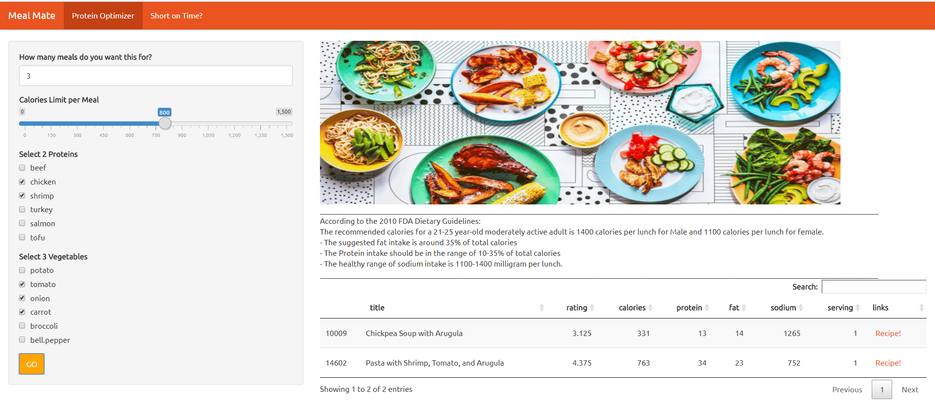
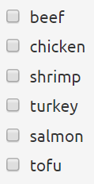
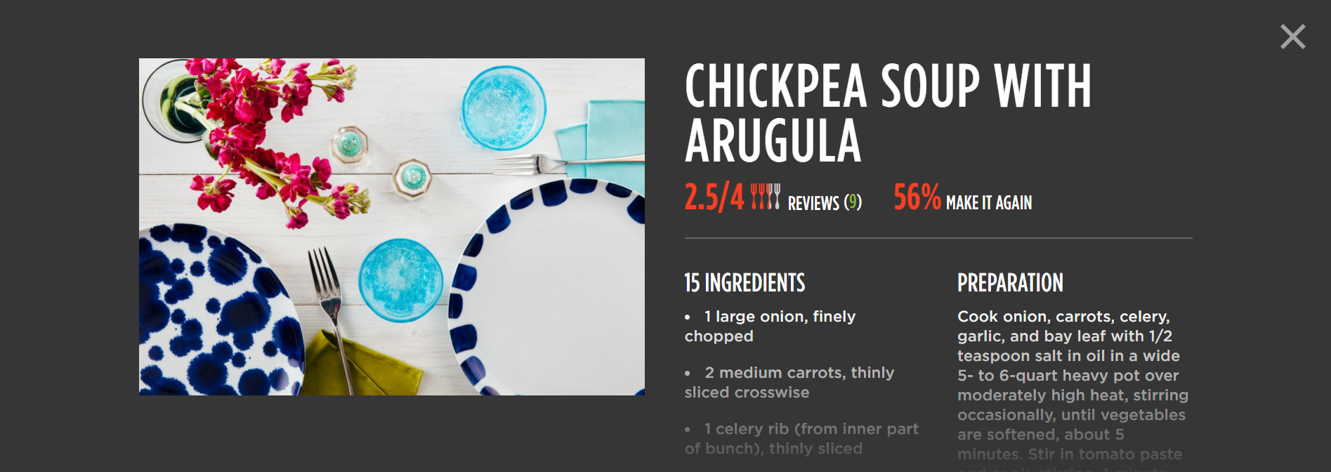

egg
duck
lamb
sausage
cottage cheese
tuna
bean
cabbage
cauliflower
mushroom
kale
celery
In collaboration with

Slide 13
Thank You!
Questions

